Slide 1

VOICE TO TEXT CONVERSION
Group - 9
Yaswanth Mareedu (801306490)
Aasish Chunduri (801308977)
Rahul Mathamsetti (801306027)
Manoj Janapala (801306993)

Slide 2

Goal of the Project
The goal of this project is to develop a real-time voice-to-text conversion system using WebRTC for live transcription of speech, and Streamlit to create a user-friendly interface.
In addition, we also implemented the conversion of the generated text into any language's voice output, making it accessible to a global audience.
By achieving these objectives, we hope to provide an efficient and user-friendly solution for people who may have difficulty with traditional methods of communication, such as those with hearing impairments or language barriers.

Slide 3
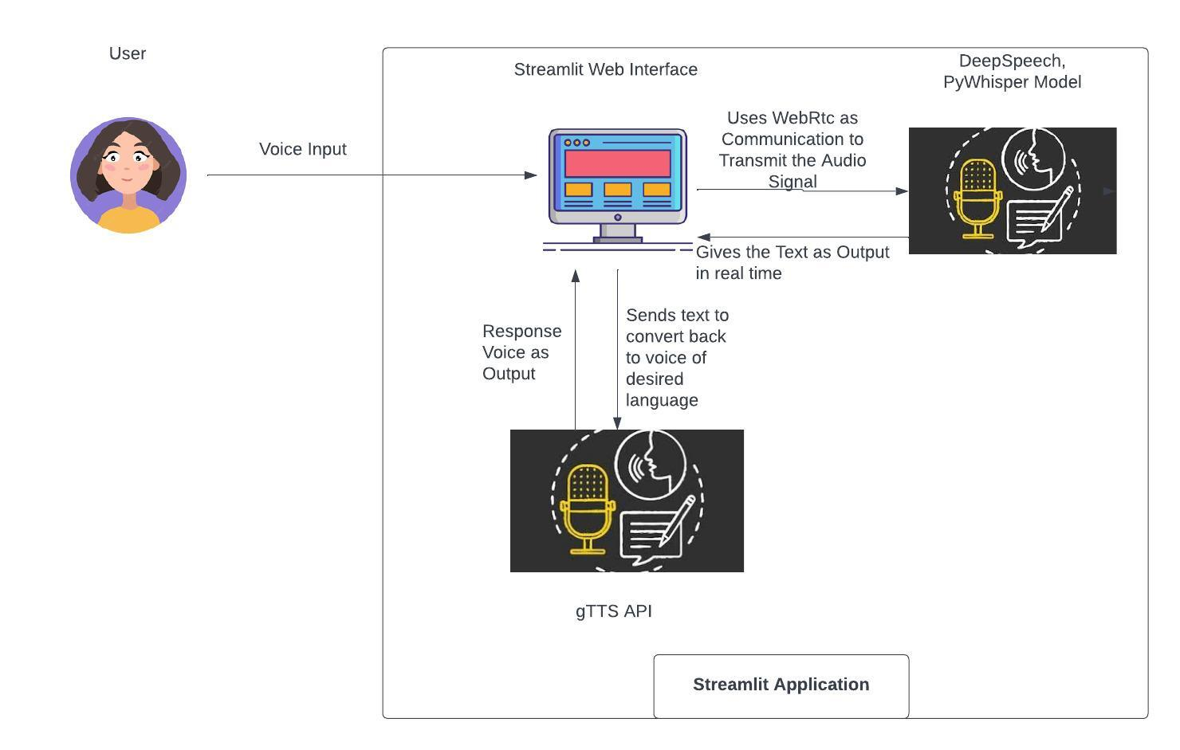
System Overview

Slide 4

Implementation
We are using the Streamlit library for creating the user interface and the Streamlit-webrtc library for capturing the audio stream.
We use the DeepSpeech library and PyWhisper model for performing the speech-to-text conversion, and the gTTS library for the text-to-speech conversion.
The model loads the DeepSpeech model and language model, and sets up the model parameters for decoding.
WebrtcStream class is used to capture the audio stream and the Pydub library for processing the audio data.

Slide 5
Contd..
The code displays the transcribed text in real-time and allows the user to select the language for the text-to-speech conversion.
The code uses the Translator class from the translate library to perform the translation, and the gTTS library for generating the speech output.
The code also includes functions for downloading the DeepSpeech model and language model if they are not already downloaded.

Slide 6


Demo

Slide 7
Challenges
First we thought of using Pywhisper to implement real time voice to text conversion but PyWhisper is unable to create a live stream using WebRTC and transfer the audio chunks lively to a model and get the results, so we used deepspeech model.
Initially we faced the version issues using streamlit webrtc and deepspeech model.
We tried deploying the model in the Streamlit cloud, but we faced os issues while running the application.

Slide 8

Thank You..

